Slide 1
Reliability and Validity
Why is this so important and why is this so difficult?

Slide 2
Reliability and Validity
The language for this is from the positivist tradition—scientific verification. Habermas’ cognitive interest of control.
In experimental research terminology:
Can we assume that the independent variable is the only cause of change in the dependent variable?

Slide 3
Application
Reliability is a discussion of data gathering techniques.
Is it possible that the data gathering technique itself is impacting the results?
Validity applies to both data gathering and, more broadly, study design.
Is there a possible alternative explanation for the conclusions of the study based on how the study was executed?

Slide 4
Methods and Limitations
Discussion of these two questions appears in both the methods section and in the conclusions
Is it possible that the data gathering technique itself is impacting the results?
Is there a possible alternative explanation for the conclusions of the study?

Slide 5
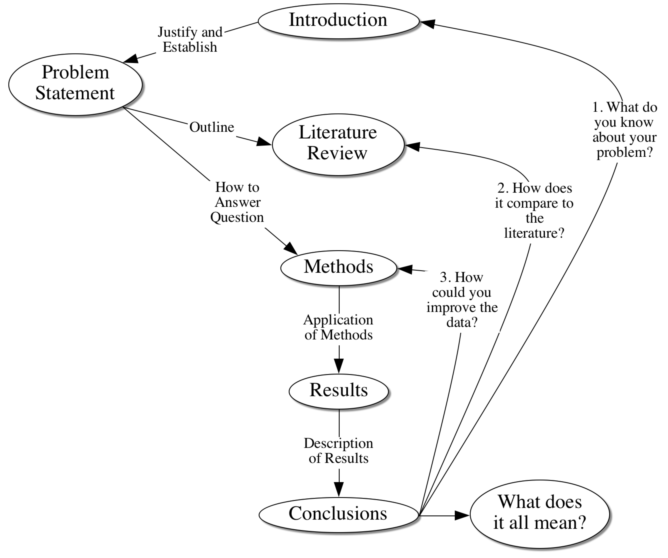
Proposal
Study Design
Delimitations
Limitations

Slide 6
Instrument Reliability
Consistency
The instrument behaves the same if it is used at different times
The instrument behaves the same if it is used with different people
Subsets of the instrument behave the same as other subsets of the instrument
All the items measure the same construct
Different versions of the instrument behave the same
Different people using the same instrument get the same results

Slide 7
Which Tests of Reliability Can and Should You Do?
Internal consistency (correlations)
Split-half correlation
Cronbach’s alpha
Notice that these are not what you would normally think of when you think about reliability.
Be cautious when authors say an instrument is reliable. What evidence are they using?

Slide 8
Instrument Validity
How would know that an instrument measures what you think it measures?
First, you would have to know what you think it measures.

Slide 9
Instrument Validity
An instrument is valid when it actually measures what you want to measure.
This is called construct validity—the degree to which an instrument measures an underlying construct.
There are a number of ways in which construct validity is supported.

Slide 10
Supporting Construct Validity
Are all of the important parts of the construct represented in the measurement instrument?
Are the elements of the measure weighted appropriately to represent their importance to the construct?
Do experts agree that an instrument is measuring what it is supposed to measure (content validity)?

Slide 11
Supporting Construct Validity
Sometimes it is important that the respondents can see that an instrument is measuring a recognizable construct, usually of importance to them (face validity).

Slide 12
Supporting Construct Validity
An instrument is valid if scores reflect what is known about a cohesive set of related knowledge (concurrent validity).
Did the scores on the instrument measuring teacher attitudes reflect the actual attitudes of the teachers?
Content validity after the fact.

Slide 13
Supporting Construct Validity
An instrument is valid if there is a strong correlation with a known assessment of some construct (criterion-related validity).
The college SAT

Slide 14
Consequential Validity
Data collection must be meaningful and appropriate to be valid.
Fair
Cost effective and efficient
Not harmful
In the end is the test worthwhile given the risks?

Slide 15
Is an instrument really measuring what you want it to measure?
Who knows if everything got covered but nothing extra?
After you used the instrument did it give you the information you needed?
Were the results similar to the results from other instruments of the related issues?
These are all checks on construct validity.

Slide 16
Is an instrument really measuring what you want it to measure?
Instruments have to be reliable or they are by definition not valid.
So, at least in the positivist world, you must indicate what you know about reliability in the methods section.

Slide 17
Study Validity

Slide 18
Study (Not Instrument) Validity in Experimental Research
Multiple plausible interpretations of the gathered data or:
Questions about the ability to generalize to groups other than the study sample
In experimental research, if studies are not designed correctly there may be:
Threats to internal validity
Threats to external validity

Slide 19
Internal Validity in Experimental Research
In an experiment you want to know that one thing (an intervention or an independent variable) caused something to happen.
So, you have to design the study so that things other than the intervention don’t have an effect on the outcomes (dependent variables).

Slide 20
Internal Validity in Experimental Research
Did something about the study design cause the results instead of the results being caused by the thing you were testing (independent variable)?

Slide 21
Internal Validity in Experimental Research
The rigor with which you make sure that only the independent variable affects the dependent variable is based on the impact of your results.
If people could die if you get it wrong you would be very careful not to get it wrong.
On the other hand, very few people die because of social science research.
Social science research is very messy so we have to apologize a lot.

Slide 22
Internal Validity in Experimental Research
There are always some things that might allow for alternative explanations of the outcomes in experimental research—things that threaten the assumption that the independent variable is the only thing responsible for a change in the dependent variable.
As a category these are called:
threats to internal validity

Slide 23
Examples of things that happen outside of your control—
Some event occurs in the participants’ lives that is related to the independent variable and affects the dependent variable
History—getting the intervention elsewhere
Maturation—getting older or better naturally
Attrition (Mortality)—leaving the study

Slide 24
Examples of problems related to data gathering—
The manner in which data are gathered impacts the dependent variable
(Assumes instrument validity and reliability)
Instrumentation—using different instruments
Testing—using the same instrument

Slide 25
Examples of problems related to respondents reaction to the research—
The individuals in the sample may react to being studied.
Evaluation apprehension—physical reaction to being studied (John Henry)
Hypothesis guessing—participants behave based on what they think the expected outcome should be (Hawthorne Effect)
Rivalry—participants knowing they are in different groups
Participant observer—your influence

Slide 26
Threats to Internal Validity
What is the best way to compensate for most threats to internal validity?
Use a control group. If a group is treated just the same except they don’t get the intervention then the impact of the threats to internal validity are reduced. The intervention group and the control are impacted by identical threats.

Slide 27
Control Groups
The problems with control groups are:
They have to be randomly selected to assume they come from the same population as the intervention group, or:
You have to demonstrate that the control group is not significantly different than the intervention group in any important way at the start of the study.

Slide 28
Control Groups
The biggest problem with control groups is that we can rarely use them in education.
True control groups get NO intervention.
What you are really doing is comparing interventions.

Slide 29
Threats to External Validity
Threats to external validity (the ability to generalize to a larger group) are usually things that make the study not replicable in another setting (things that can’t be duplicated).
Any threat to internal validity
Experimenter affects results
Variables are too specific
Confirmatory bias (Thomas Kuhn)
Specificity of context

Slide 30
Threats to External Validity
Notice these are things that look like they might apply in a qualitative study also.
Experimenter affects results
Variables are too specific
Confirmatory bias (Thomas Kuhn)
Specificity of context

Slide 31
Methods Section and Validity
How to help the reader know what you did. Precisely.
Everything in the methods section is related to your purpose statement.
The methods section is to help your reader know that your study is valid and reliable (trustworthy if you are doing a qualitative study).
Qualitative and quantitative methods sections are somewhat different.

Slide 32
Methods Section and Validity
Context of the study
Will the results transfer (external)
Could the environment affect the measures (internal)
Sample(s)
Is the sample similar to others in another context? (external )
Are comparative groups similar? (internal)
Were participants selected randomly? (internal)
How were groups selected (both)

Slide 33
Methods Section and Validity
Intervention
Could this be done elsewhere (external)
Are methods reproducible (external)
Were methods appropriate to the study (internal)
Alternative possible explanations (internal)
Data gathering
Are the measures reliable (internal—instrument)
Are the measures valid (internal—instrument)

Slide 34
Methods Section and Validity
Analysis
Were analysis methods based on appropriate assumptions (internal)
Were appropriate analysis methods used (internal)

Slide 35
Conclusions and Validity
Limitations
The limitations section is a discussion of all the possible threats to validity in your study. There will ALWAYS be some.

Slide 36
Threats to Validity

Slide 37
Validity and Proposals
In a thesis proposal you must talk about delimitations and limitations
Delimitation is the circle you draw around your study (parameters within which you work).
Limitations are the things that might impact the interpretation of the results (validity).
In doctoral research the expectation is that you reduce the limitations as much as possible.

Slide 38
Qualitative Validity—Generalizability
Many qualitative researchers feel that positivist ideas about validity make no sense in qualitative research.
A different approach is to gather as much data as possible from multiple sources.
The more corroborating evidence there is, the more the study is trustworthy.

Slide 39
Read Wolcott

Slide 40
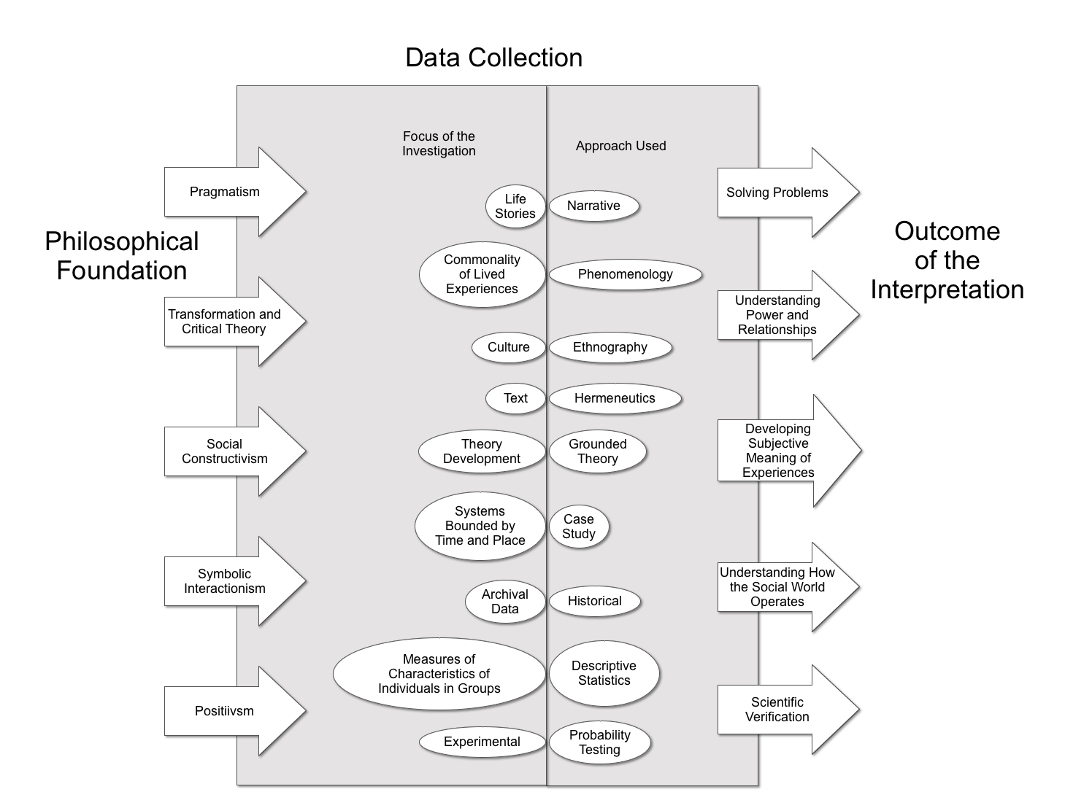

Slide 41
Basic Qualitative Strategies
Cap Peck, 1991

Slide 42
Research Question
Beginning with less specific research questions
Start with interests and a sense of the research situation
Study designs (including the research question) emerge

Slide 43
Sampling
Participants are identified for the information they may contribute.
Sampling purposes
Based on the types of information you need

Slide 44
Data Collection
Observations
Separate descriptions from interpretations
Interviews
Informants provide descriptions of culture and experience
Grand tour questions

Slide 45
Data Analysis
Done as data are collected in the study
Conceptualizing themes for sorting
Constant comparative
Memos
Theoretical notes
Methodological notes
Analytic memos

Slide 46
Trustworthiness
Quantitative Reliability
The degree to which data gathering remains consistent over different iterations or time.
Quantitative Validity
The degree to which you can defend what you think you found as what was really there.
Qualitative reliability and validity are based on the degree to which a study is trustworthy.

Slide 47
Credibility
Data gathering is:
Prolonged
Persistent
Triangulated
Peer briefing
Negative case analysis
Referential adequacy
Member checks

Slide 48
Transferability
Context bound description
External validity
Thick description
Context
Observation and interview

Slide 49
Audit Trails (Methods)
Dependability
Stability of the data
Confirmability
Neutrality of the data
The reflexive journal
Tracking biases and assumptions

Slide 50
Presenting Findings
Case study description
Pre-assigned coding systems
Emergent themes
Levels of abstraction
Exemplars
Diagramming relationships

Slide 51
Hermeneutics
The importance of context in understanding
Habermas
Control (Clarification of causal relationships)
Communication (Establishing understanding among actors)
Emancipation (Transforming the givens)
Why talk about this?

Slide 52
Mixed Methods

Slide 53
The Transition to Quantitative Creswell and Mixed Methods Design
Where do they over lap?
What do you need to know to used mixed methods?
Study designs
Exploratory—Using qualitative methods to design quantitative data collection
Explanatory—Using qualitative methods to enhance a quantitative explanation
Triangulation—Using both: quantitative methods to enhance a qualitative explanation

